Slide 1
Launching reception for:
Honours Minor Degree Program in japanese Studies
Japanese Section
Department of Languages, Literatures and Linguistics
York University

Slide 2
Welcome
Professor kim michasiw
Vice Dean
Faculty of Liberal Arts and Professional
Studies

Slide 3
Guest
Mr. takashi ishida
Executive Director
The Japan Foundation, Toronto

Slide 4
Guest
Professor
Pietro Giordan
Chair
Department of Languages, Literatures and Linguistics
York University

Slide 5
Guest
Mr. Tetsuo Komuro
CEO
Mitsui & Co. (Canada) Ltd.

Slide 6
guest
Professor farrokh zandi
Associate Director
BBA/iBBA Program
Schulich School of Business

Slide 7
guest
Ms. beverly ohashi
Principal
Laureate
International College

Slide 8
Olender Vivian manager, curriculum
Provenzano Roberta Iannacito DUP, DLLL
Anderson Gordon Coordinator, eas
Kono Chieko Director, JFT
Saito Noriko Program officer, jfT
Pragg Suzanne program officer, jft
Tanaka Kaori planning officer, jft
Goulding Jay prof. social sciences
Chin Chung Ying community member
Handa Mizue former faculty
Ota Frances minister, ucc
Shinoda Akiko guest speaker
Sansonetti Josie assistant to chair, dlll
Lee Ahrong korean faculty
Choi Yujeong korean faculty
Poole Jim coordinator, vC, UIT
Introduction of other guests

Slide 9
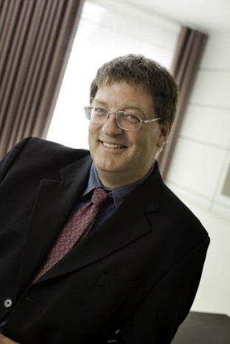
Professor Ken Coates
Former President of JSAC, University of Saskatchewan
Despite widespread news about the supposed decline in the Humanities, there is a fascinating and positive trend on many university campuses in Canada. Students are genuinely interested in language and cultural studies. At York University, where Professor Norio Ota has been leading a long-term effort to promote the academic study of Japan, enrollment numbers have been strong and growing. Buoyed by strong student interest, Professor Ota and his colleagues have been working tirelessly to create a new Minor in Japan Studies. As the past President of the Japan Studies Association of Canada, I had the opportunity to examine the proposal that was placed before York University. The Minor is a model of academy efficiency and impact, allowing students to combine their interest in Japan with studies in other discipline. On behalf of JSAC, I was delighted to endorse the Minor proposal. I was even more pleased to learn from Professor Ota that the program had been approved by the York Senate. Japan Studies remains strong in Canada, driven by the joint commitment of students eager to learn about the country and faculty members like Professor Ota. Congratulations to the Japan Studies faculty members at York. Many thanks to the Japan Foundation for their continuing support of Japan Studies in Canada. This is a wonderful achievement in Japan Studies.

Slide 10
Professor Sheila Embleton
Former VP Academic, York University
I'm sorry I can't be with you today. I'm in Banff for the Royal Society of Canada meetings -- at the induction of two colleagues whose files I prepared last year, Bettina Bradbury and Adrian Shubert (our former Associate VP International). I was delighted to hear that this Japanese minor program had finally passed all our myriad internal approval processes at York. One sometimes has to wonder how such good ideas can take so long to implement, at a university that considers itself innovative and at the forefront of internationalization. I remember that Norio's vision of having at least a minor in Japanese began during my term as VP Academic & Provost, and I was of course pleased to be able to support it in whatever ways I could, which was mostly via advice and sending supportive thoughts his way, because it was his energy and determination that carried this through from concept to reality. York has been a national leader in teaching Japanese, largely ascribable to Norio's leadership, supported further by an extremely able set of other professors and instructors throughout the years and including currently. Our Japanese language teaching program has been phenomenally successful, as evidenced for example by continuing large enrolments and the number of our students who have won significant prizes in the provincial and national Japanese Speech Competitions over many years. Norio's innovations in the technology of language teaching have been both praised highly and used, both inside York (Glendon) and outside York (St Mary's, Havana). The Asia Pacific Foundation of Canada has just released (Tuesday, November 5) its report, Canada's Asia Challenge; Creating Competence for the Next Generation of Canadians (one of the panellists was our own Michael Stevenson). This report worries about Canada's knowledge of Asia and therefore Canada's ability to compete, to take advantage of the economic prosperity that deeper relationships with Asia can bring to all Canadians. Language is a part of this, but so also are culture, history, law, the fine arts, etc. There is little national vision around this, but instead what the report calls "islands of excellence", of which we need many many more. I am so happy that one of those islands of excellence in the development of Asia competence in the next generation is York University, and that the Japanese program is one of our clear strengths. The launch of the Japanese minor then is one further part of that, a very visible part, and will do its share of improving Canada's Asia competence -- a small part of this much bigger picture. And I know Norio has yet more plans to enhance the Japanese program, and further develop Asia competence in our students, but I'll leave my praise of that to the next reception. Again, sorry for my absence, but please accept my warm congratulations on achieving this important milestone.
Sheila

Slide 11
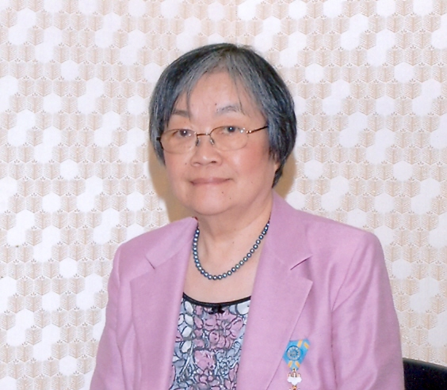
Professor Fumiko Ikawa-Smith
Former President of JSAC, McGill University
Hallo, Everyone!!
I am honoured to have this opportunity to send a congratulatory message on the occasion of launch of the Honours Minor Program in Japanese Studies at York University.
As one of the founding members of the Japan Studies Association of Canada (JSAC), established in 1987, and its past President (1999-2000, 2004-2007), I always find it encouraging to see a new Japanese Studies program being launched at a Canadian university. This Program being inaugurated today is of a particular interest, as it is the only program that is fully web-based, offering the benefits to students in a much wider area than usual, thus contributing effectively to the development of Japanese Studies in Canada. The Program is also unique in Canada, and probably in North America, in that it places the primary emphasis on acquisition of advanced language skill, not simply as a tool for conducting research as part of an interdisciplinary East Asian Studies program. Yet, the program clearly provides sufficient instruction in Japanese culture and society, and on cross-cultural and non-verbal communication.
With this degree program in place, York students, on graduation, will have tangible credential of the high quality of the training they received at the University, which has been attested by the excellent records York University students have attained at such events as Japanese language speech contests and JSAC-sponsored essay competitions over the years.
Congratulations again, to Ota-sensei, and everyone at York University!!
Fumiko Ikawa-Smith, PhD

Slide 12
Professor martin singer dean
Faculty of Liberal Arts and Professional Studies
Dr. Vivian Olender, Ph.D.
Curriculum Manager
Faculty of Liberal Arts and Professional Studies
Office of the Dean
Professor Sheila embleton former vice president academic & provost ms. Cheryl Underhill
Assistant Secretary of the University
University Secretariat rev. Frances e. ota
Minister
United church of canada
Special thanks to:

Slide 13
Students
Ms. Lily mcdermit
Mr. Tony Diu
AP/JP3000 6.0
Advanced Modern Standard Japanese

Slide 14
Prof. kiyoko toratani prof. noriko yabuki-soh prof. kumiko inutsuka prof. akiko mitsui prof. norio ota (coordinator)
Faculty members
Japanese Section

Slide 15
Japanese Studies Program @ York University
Japanese Studies Program at York University offers Japanese language courses for all levels as well as courses on culture, pedagogy, linguistics and translation. The program takes advantage of Technology Enhanced Learning (TEL) to enhance teaching and learning. It emphasizes students’ acquisition of socio-cultural knowledge for successful cross-cultural communication with Japanese.
Courses: AP/JP1000 6.0 Elementary Modern Standard Japanese AP/JP2000 6.0 Intermediate Modern Standard Japanese AP/JP3000 6.0 Advanced Modern Standard Japanese AP/JP4000 6.0 Advanced Readings in Modern Standard Japanese AP/JP2700 6.0 Contemporary Japanese Culture and Society AP/JP3070 3.0 Japanese Language in the Media AP/JP3100 3.0 Japanese Linguistics I: Structure of Modern Japanese Language AP/JP3150 3.0 Japanese Business Culture and Communication AP/JP3200 3.0 Japanese Linguistics II: Structure of Modern Japanese Language AP/JP3751 3.0 Japanese Business Culture and Communication AP/JP3800 6.0 Co-op in Japanese Studies (pending Faculty approval) AP/JP4010 6.0 Classical Japanese AP/JP4100 6.0 Teaching of Japanese as a Foreign/Second Language AP/JP4120 6.0 Translation: Japanese - English; English – Japanese AP/JP4900 6.0 Independent Reading and Research
Study Abroad in Japan at: Dokkyo University, Keio University, Meiji University, Hitotsubashi University, Waseda University (Tokyo area) or Nagoya University (Central Japan area). Certificate of Language Proficiency Other opportunities: Japanese Language Proficiency Test, Ontario and National speech contests, summer internship, and more.

Slide 16
Honours Minor Degree program in Japanese Studies
The Honours Minor in Japanese Studies may be combined with any approved Honours B.A. program that offers a major/minor option in the Faculties of Environmental Studies, Health, Liberal Arts and Professional Studies, Fine Arts or Science and Engineering. For further details on requirements, refer to the listings for specific Honours programs that may be pursued jointly with other Faculties.
The Honours Minor program provides students with an advanced level of language proficiency and advanced knowledge and understanding of the area studies they choose.
Minimum requirements for Honours Minor Degree Program : All students must take at least 36 credits within the course offerings of Japanese Studies, of which at least 6 credits must be at the 4000 level. Those who are exempted from AP/JP1000 6.00, AP/JP 2000 6.00 or AP/JP 3000 6.00 must take AP/JP 4000 6.00 and at least one more 4000 level course. 36 credits including:
Japanese Studies Core - 24 credits (compulsory): | 12 additional credits at the 3000 or 4000-level chosen from:
AP/JP1000 6.0 AP/JP2000 6.0 AP/JP2700 6.0 AP/JP3000 6.0 | AP/JP3050 3.0 AP/JP3070 3.0 AP/JP3100 3.0 AP/JP3150 3.0 AP/JP3200 3.0 AP/JP3800 3.0 | AP/JP4000 6.0 AP/JP4010 6.0 AP/JP4100 6.0 AP/JP4120 6.0 AP/JP4900 6.0

Slide 17
Please visit the following web site of the japanese studies program.
URL: http://buna.yorku.ca/
Please contact the coordinator of the Japanese studies program.
Professor Norio Ota phone: 416-736-2100 ext. 88750 e-mail: nota@yorku.Ca
For further information:

